Slide 1

BudgetWise AI
Intelligent Personal Finance Management
Powered by machine learning to revolutionize how Indians manage their personal finances

Slide 2

The Financial Crisis Facing India
73%
₹47K
63%
Indians Struggle
Average Debt
No Savings
with money management
per household
plan or budget
89%
Want AI Help
for financial decisions
Manual tracking is tedious, Excel is complicated, and existing apps don't understand Indian banking systems

Slide 3

Current Problems:
Users cannot accurately predict future expenses
Manual budgeting is time-consuming and error-prone
High variability in spending patterns
Existing tools ignore personalized behavior
Limited insights for proactive financial planning
Existing Solutions:
Simple averages and trend-based forecasts
Basic budgeting apps with manual entry
Rule-based alerts for overspending
Category-wise expense summaries
Limited prediction horizon (short-term only)

Slide 4
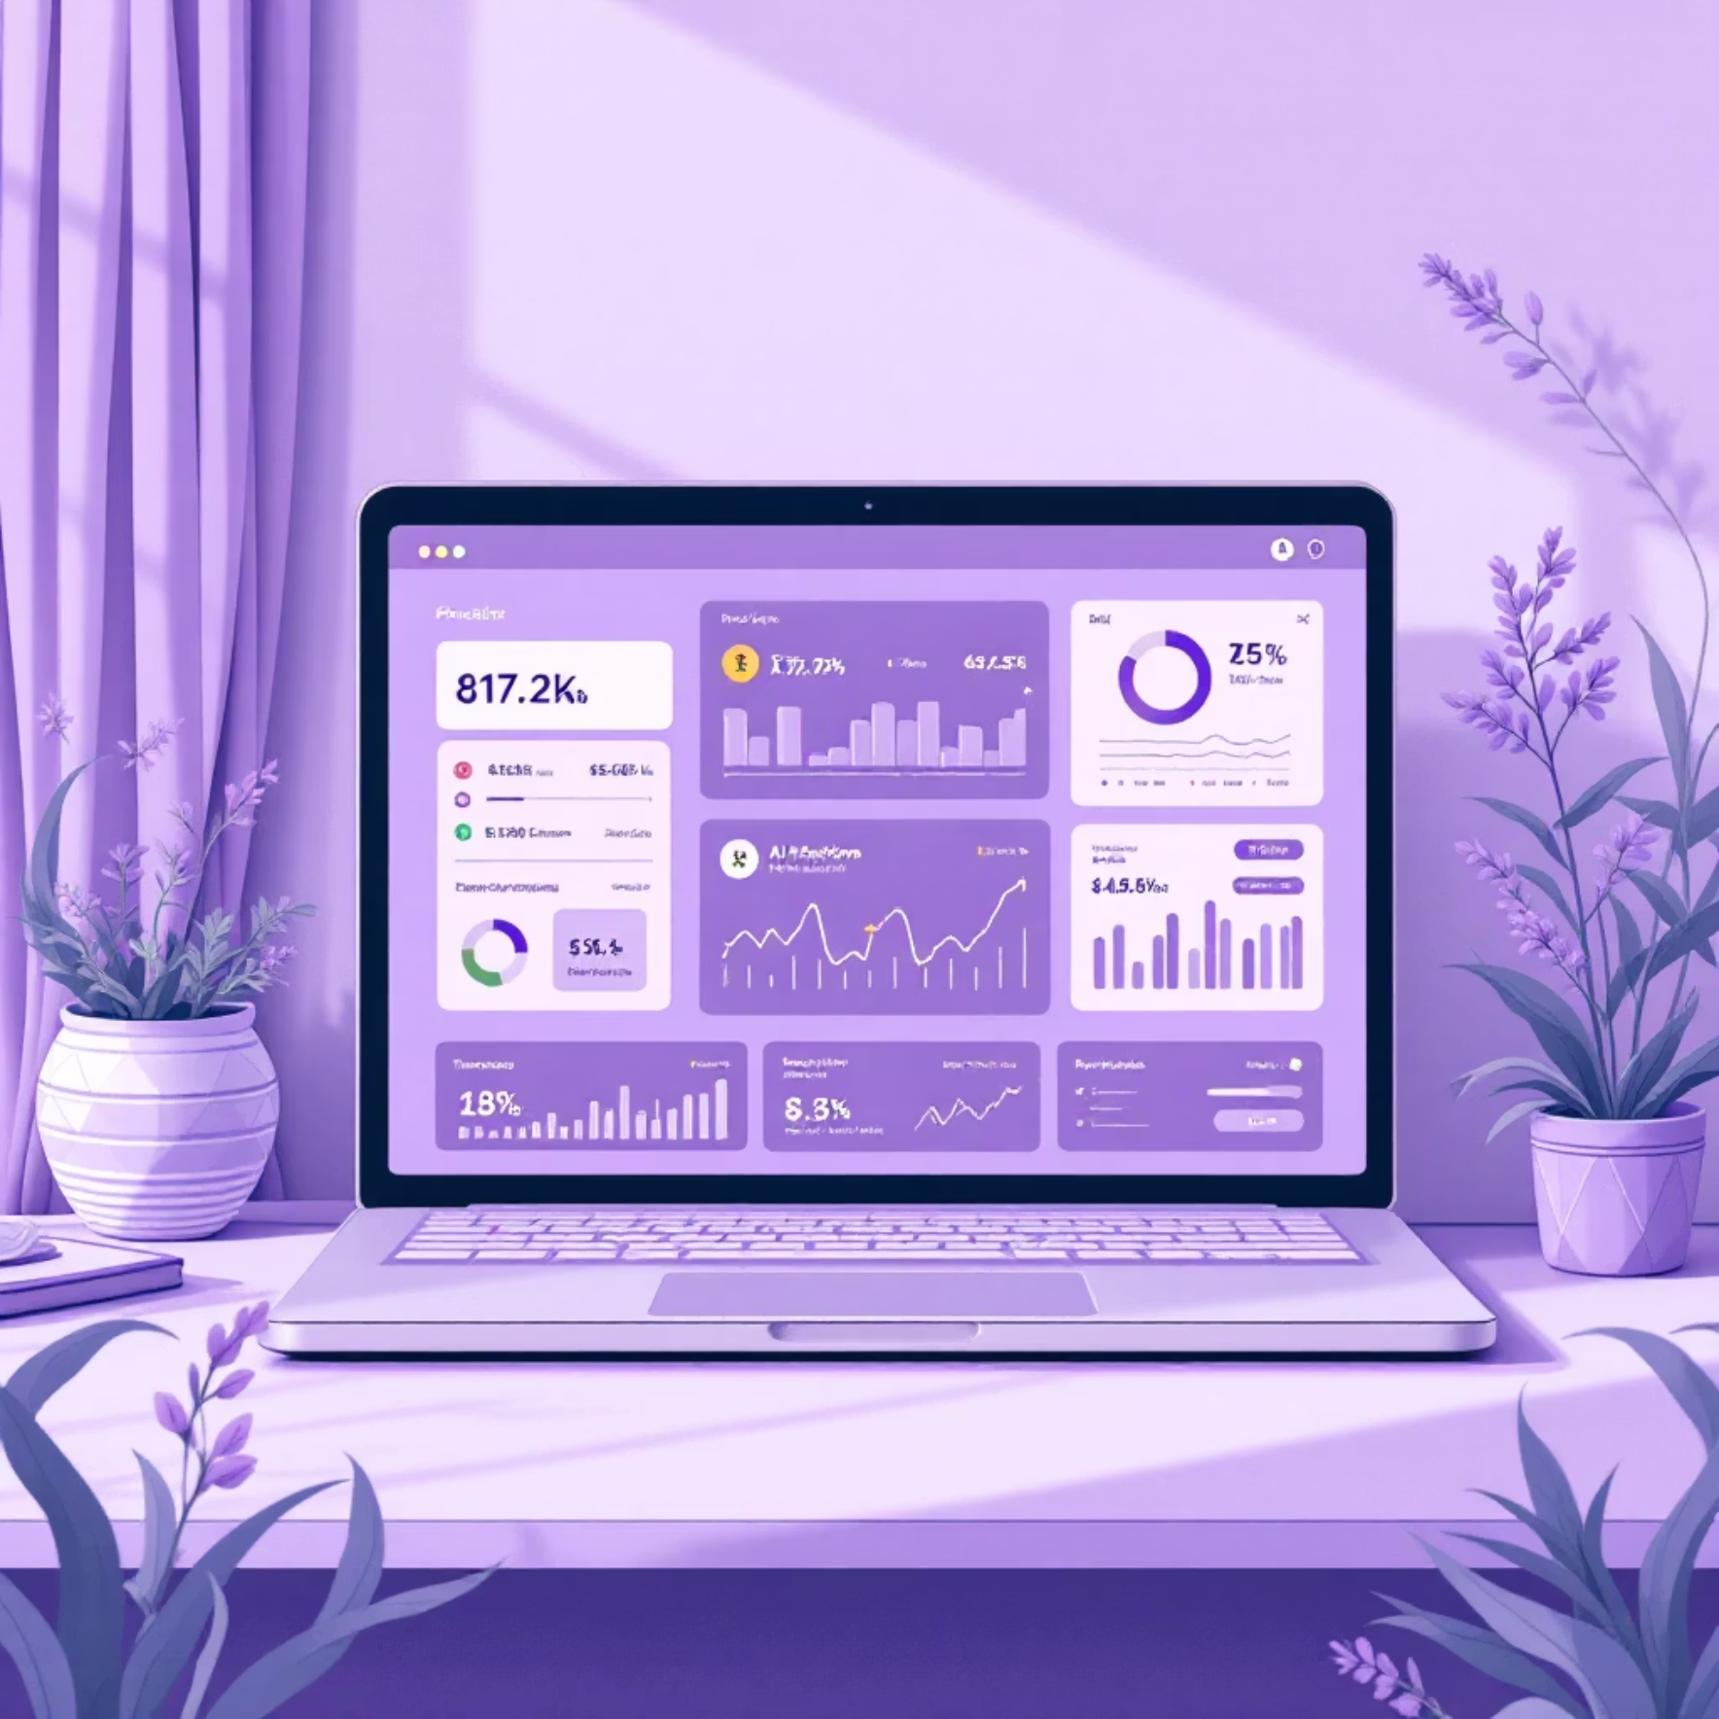



Introducing BudgetWise AI
What We Built – Our Solution
Smart expense tracker with auto-categorization
AI-powered spending predictions
Professional PDF reporting
Multi-bank CSV support
intelligent budget management
Real-time analytics dashboard
73%
30
85%
Prediction Accuracy
Confidence Level
Forecast Days

Slide 5


Technical Architecture
Built on modern, scalable architecture patterns for enterprise-grade performance
Presentation Layer
HTML5, CSS3, JavaScript - Responsive web interface with interactive charts and real-time updates
Application Layer
Flask, SQLAlchemy, Jinja2 - RESTful API design with MVC architecture for business logic processing
Data Layer
SQLite (Dev), PostgreSQL (Prod) - Optimized database with indexing and relationship management

Slide 6





Modern Technology Stack
Leveraging cutting-edge technologies for optimal performance and scalability
Python 3.11 & Flask
TensorFlow & LSTM
Backend API development with modern Python frameworks for robust server-side processing
Advanced machine learning models for accurate financial predictions and pattern recognition
PostgreSQL & SQLAlchemy
JavaScript & Chart.js
Enterprise-grade database management with ORM for efficient data operations
Interactive frontend with dynamic visualizations and responsive user experience
15+ technologies, 5000+ lines of code, 2 months of intensive development

Slide 7
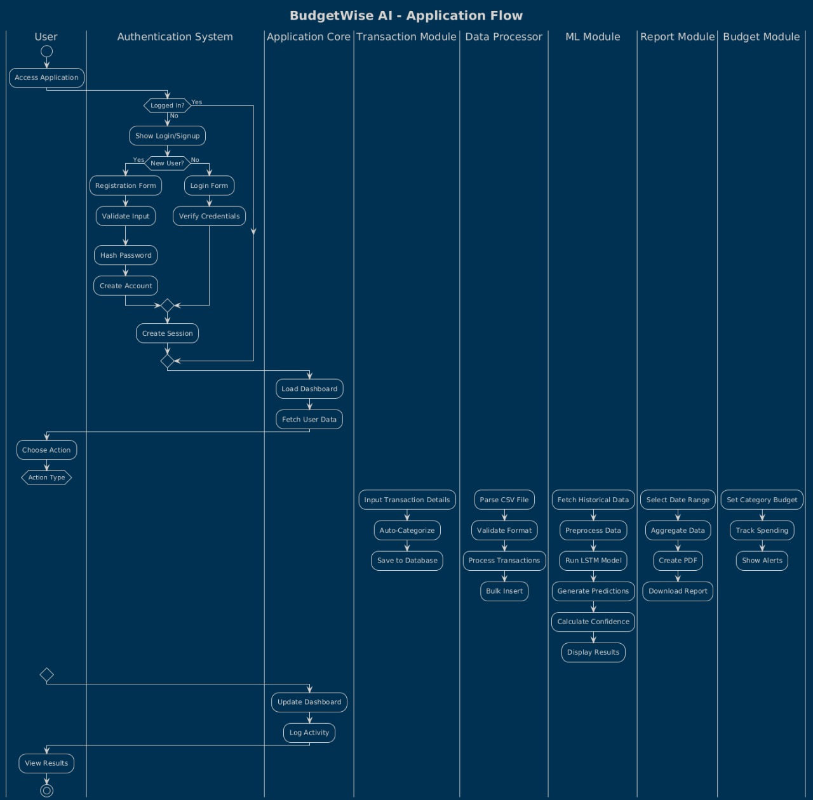
BudgetWise - Application Flow
User signs up / logs in
Adds income & expenses
Data stored & processed in backend
AI predicts expenses & suggests budget
Dashboard shows insights & notifications

Slide 8
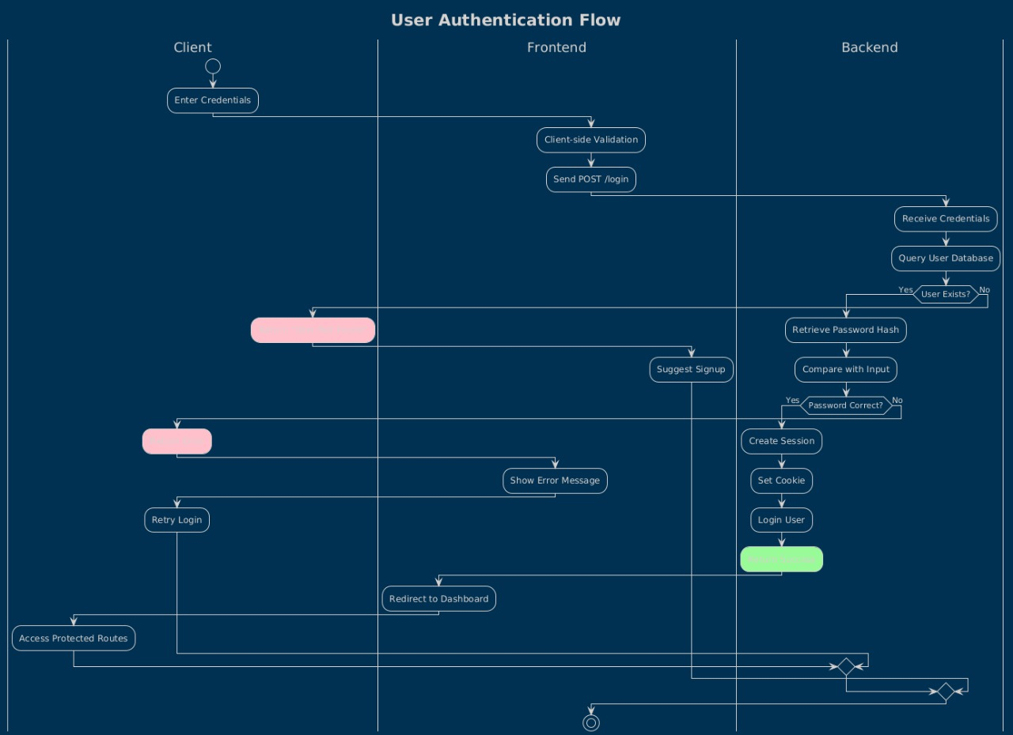
Authentication Flow
User opens the app and navigates to login/signup
Enters credentials (email & password)
Backend verifies credentials with database
On success, user session/token is generated
User redirected to the main dashboard

Slide 9
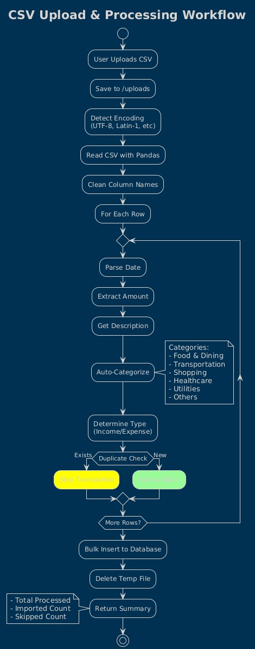
CSV Upload & Processing Workflow
User uploads CSV → saved to /uploads
Detect encoding and read CSV
Clean column names
Parse each row: date, amount, description
Auto-categorize transactions (Food, Transport,
Shopping, Healthcare, Utilities, Others)
Determine type: Income / Expense
Check duplicates → insert new rows to database
Delete temp file
Show total processed (imported vs skipped)

Slide 10
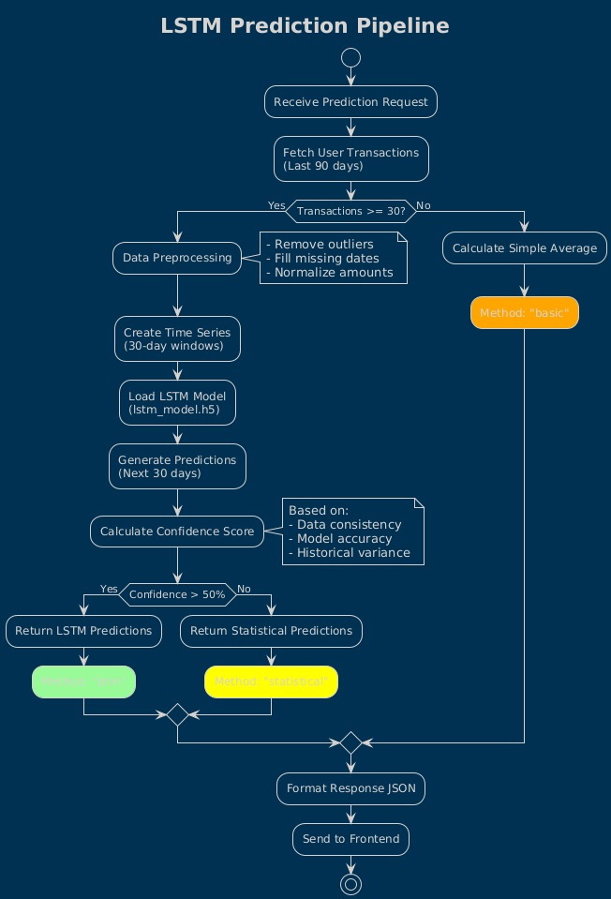
LSTM – Prediction Pipeline
Receive prediction request
Fetch last 90 days of user transactions
Transactions ≥ 30?
Yes → Preprocess data
No → Return statistical predictions
Data preprocessing: remove outliers, fill missing dates,
normalize amounts
Create 30-day time series
Load LSTM model (lstm_model.h5)
Generate 30-day predictions
Calculate confidence score
Confidence > 50%?
Yes → Return LSTM predictions
No → Return statistical predictions
Format JSON response
Send to frontend

Slide 11






Comprehensive Feature Overview
Secure Authentication
Real-time Analytics
Bcrypt password hashing
Interactive Chart.js visualizations
Email verification system
Spending trend analysis
Session management
Category breakdowns
AI Predictions
CSV Import System
LSTM neural network model
Multi-format bank statement support
30-day spending forecasts
Automatic transaction categorization
85% prediction accuracy
Bulk processing capabilities
Budget Management
Professional Reports
Category-wise budget allocation
PDF export functionality
Progress tracking and alerts
Custom date range selection
Spending limit notifications
Formatted financial summaries

Slide 12





Enterprise-Grade Security
Multi-layered security approach protecting user data at every level
Authentication Layer
Bcrypt password hashing, JWT tokens, and 2FA-ready implementation for secure user access
Data Protection
Encryption at rest, HTTPS/TLS in transit, and complete user data isolation
Application Security
SQL injection prevention, XSS protection, CSRF tokens, and secure session management
Infrastructure Security
Firewall rules, rate limiting, DDoS protection, and comprehensive security monitoring

